Slide 1
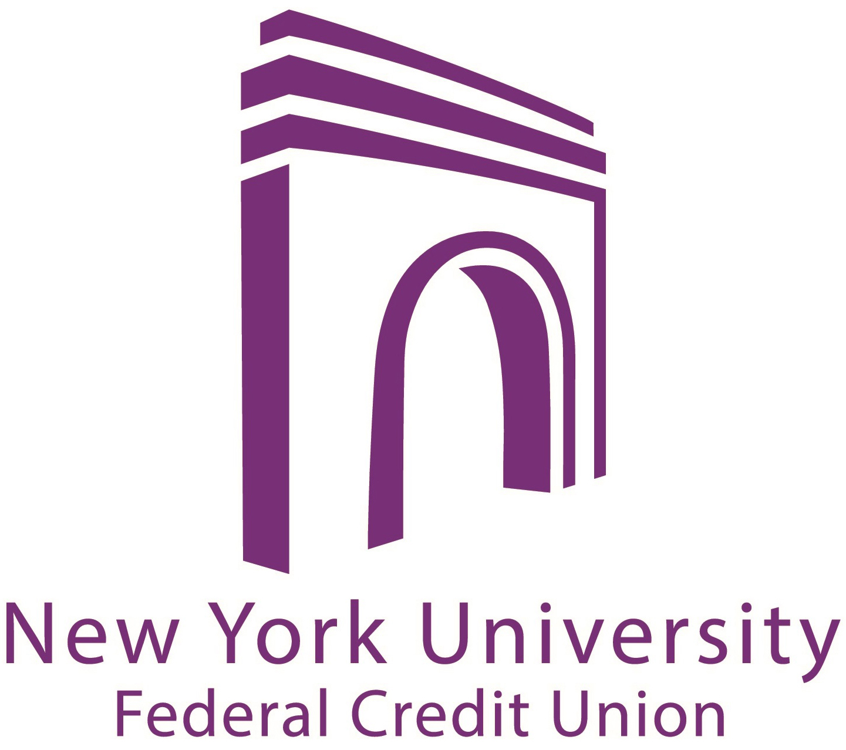
Not All Mortgages are Alike: Learn Which is Right for You
April 22, 2014
Fall 2016

Slide 2
Introduction
During this seminar we will discuss:
Mortgage loan types
(Adjustable vs. Fixed Rates)
General mortgage information
Points
Payment examples

Slide 3
How Do You Choose the Right Mortgage?
There is a wide selection of mortgages available in today’s
market, you can narrow the field by considering your situation.
Your choice of mortgage will be influenced by questions such
as:
How many years do you expect to live in your new home?
Is this your first home, home for your family, or your home for
when you plan to retire?
How much of your monthly income do you feel comfortable
using for your mortgage payment?
Do you anticipate future income changes?

Slide 4
Advantages of Fixed Rate Mortgages
If you intend to live in your home for many years, the interest
rate of your loan may be your main consideration.
A fixed-rate mortgage will ensure that your interest rate will
remain the same for as long as you have your loan.
A fixed-rate mortgage will offer you:
Security against rising interest rates
Easier budgeting of your monthly debt

Slide 5
Fixed Rate Mortgage Disadvantages
Fixed rates tend to be higher than adjustable mortgage rates, and require greater income to qualify.
If interest rates drop, refinancing is required in order to take advantage of lower interest rates.

Slide 6
Advantages of Adjustable Rate Mortgages (ARMS)
If you are confident that your income is going to increase steadily over the years, or if you plan to move in a few years then you may want to consider an Adjustable Rate Mortgage.
Adjustable Rate Mortgages offer lower initial interest rates.
Lower initial monthly mortgage payments allow you to qualify for a larger mortgage amount.

Slide 7
Adjustable Rate Disadvantages
Possible rate increases
Increase in interest rate results in a payment increase
Budget may be strained with interest rate and payment increase

Slide 8
How Do You Choose the Right Mortgage?
A wide selection of mortgages is available in today’s
market --- narrow the field by considering your situation.
Your choice of mortgage will be influenced by questions such
as:
How many years do you expect to live in your new home?
Is this your first home, home for your family or your home for
when you plan to retire?
How much of your monthly income do you feel comfortable
spending on your housing expense?
Do you anticipate future income changes?

Slide 9
Mortgage Types- (ARMs)
5/1: Rate is fixed for 5 years then adjusts annually thereafter
7/1: Rate is fixed for 7 years then adjusts annually thereafter
10/1: Rate is fixed for 10 years then adjusts annually thereafter

Slide 10
Adjustable Rate Mortgages (ARMs)
All NYUFCU adjustable rate mortgage loans have annual and lifetime caps
Terms of 15 and 30 years

Slide 11
General Mortgage Information
Debt to Income Ratios (DTIs)
DTIs, a comparison of housing expenses and other debts to gross wages, represent a members ability to repay
Acceptable DTIs are typically 28% for housing and 36% for total debt. Example:.
- Monthly gross income $10,000
- Maximum Housing Payment: $2,800 (28%)
- Total Debts Including Housing: $3,600 (36%)
Loans with DTIs in excess of 40% require increased scrutiny. PMI will typically not insure a loan with a total debt ratio greater than 43%

Slide 12
General Mortgage Information
Credit Scoring
NYUFCU uses a “representative” FICO credit score to evaluate member mortgage applications. The “representative" credit score is the mid score of the three risk scores. If more than one individual is applying for a loan, the underwriter must determine the single representative applicable score for each borrower and then select the lowest representative score for determining the comprehensive risk for the mortgage loan application.
Example: Mr. & Mrs. Smith
Mr. Smith has 3 scores: 705, 720, 735; his representative score is the middle score of 720.
Mrs. Smith has 3 scores: 660, 685, 692; her representative score is 685.
Since they are applying for a joint loan, the lower of their two representative scores is used for qualification purposes, which is 685.

Slide 13
What are Discount Points?
Discount Points are fees collected by the lender in exchange for a lower interest rate
1 point is = 1% of the loan amount
Items to consider when deciding to use discount points:
- How long you plan to remain in the property.
- Are adequate funds available to cover the cost?
- Is monthly savings sufficient to make points worthwhile?

Slide 14
Payment Comparison
Purchase Price: $500,000
Down Payment (10%): $50,000
Loan Amount: $450,000
Lets compare the payments using fixed and ARM rates

Slide 15
Fixed or Adjustable
30 Year Fixed Rate
4.375%
Zero points
Loan amount $450,000
$2,246.78 P & I payment

Slide 16
Fixed or Adjustable
7/1 Adjustable Rate Mortgage
3.500%
Zero points
Loan amount $450,000
$2,020.70 P & I payment

Slide 17
How to Decide
The payment for the 7/1 ARM is $226.08 less than for the fixed rate loan. The annual savings is $2,712.96 and over 7 years the savings total $18,990.72.
If planned period of ownership is relatively brief, consider the adjustable rate mortgage
If rate instability is a concern and you prefer to know exactly what your payment will be, choose the fixed rate

Slide 18
How to Decide
The payments on the previous slide do not include your real estate taxes, private mortgage insurance (if applicable,) home owners insurance or home owner association fees, if applicable. For Co-op units the examples do not include the maintenance payment.
Don’t forget to consider these monthly costs

Slide 19
Mortgage Preparedness Loan
NYUFCU now offers a Mortgage Preparedness Loan. The loan is designed to consolidate existing debt, frequently at a lower interest rate, and provide lower monthly payments.
The consolidation loan may improve your credit profile and score and the increased cash flow may allow you to qualify for a larger mortgage loan.

Slide 20
Down Payment Assistance Loan
NYUFCU is very excited to offer a new Down Payment Assistance Loan. The loan comes in the form of a second mortgage, equal to up to 10% of the purchase price.
Combined with your own 10% cash down payment, a full 20% down payment is made, the primary mortgage is for 80% of the purchase price and mortgage insurance (PMI) is no longer required.

Slide 21

Summary
Now is a great time to buy a home:
Mortgage rates are still at all time lows.
Property values have stabilized.
There is growing inventory in the New York-New Jersey market.

Slide 22
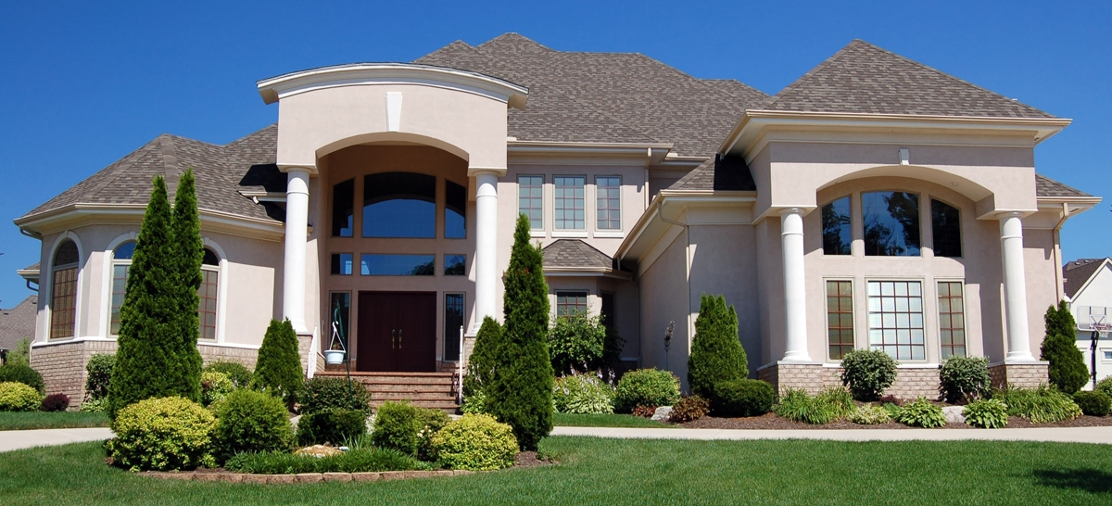
Questions?

Slide 23


Feel free to contact us
Visit us online at www.nyufcu.com to download a Mortgage Loan Application Checklist or the interactive Mortgage Loan Application.
Follow us for promotions and new services:
Main Office
NYU Federal Credit Union 726 Broadway, Suite 110
New York, NY 10003 Phone: 212-995-3166
@NYUBanking
NYU Federal Credit Union

Slide 24

Make an Appointment
Make an appointment with NYU FCU for a free Pre-Approval. Call 212-995-3166.
An NYU FCU Representative can assist you: -Calculate the estimated total monthly payment. -Find the right product for you.
NYUFCU team

